Slide 1
Review Analysis
Web scraping to gain company insights
26/11/2022

Slide 2
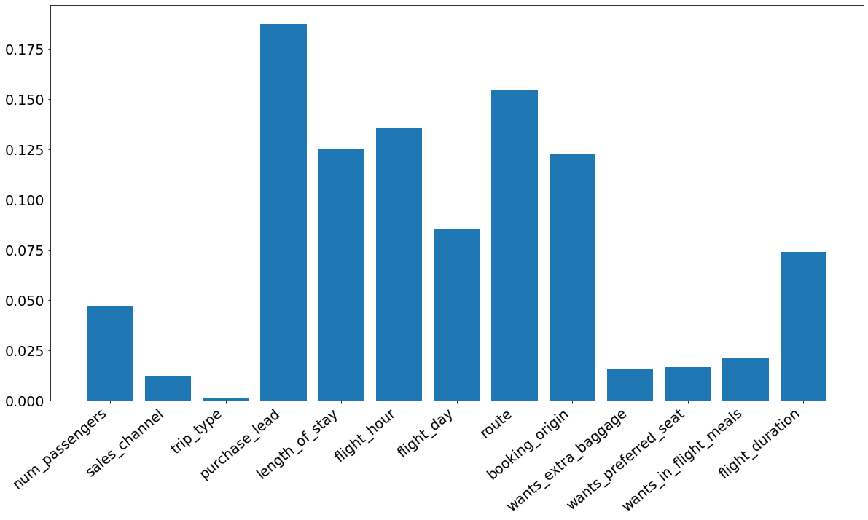
Insights
From my modeling, we achieve an accuracy of 85.46% on our Test Data, with minimal tuning
From the RandomForestClassifier model, we can see that there are are several features that are far more important to predict the target variable than other.
Among the most influential attributes, we have : purchase_lead, route, flight_hour, length_of_stay, and booking_origin in the descending order order of most influential attributes
Meanwhile, among the least influential features, we have : trip_type, sales_channel, wants_extra_baggage, want_preffered_seat, and wants_in_flight_meals in ascending order of least influential attributes

